Slide 2
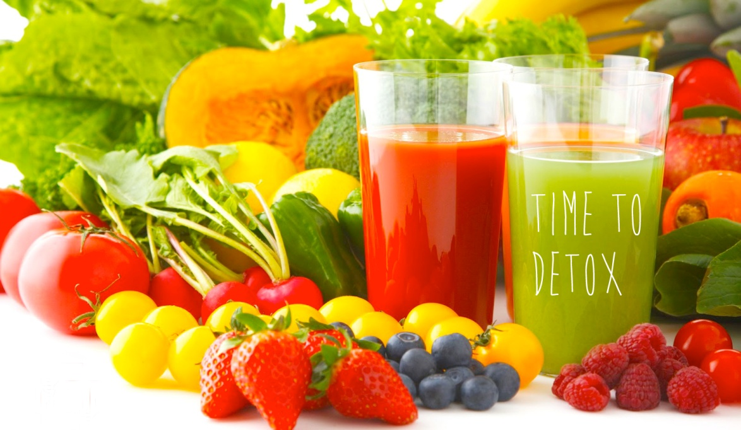
from the Inside Out
To get Healthy (and Lose Weight)
We must Cleanse (Detoxify) our Body to lose Toxic Fat/Weight
We do this by Taking Out Allergenic Foods, Cleaning the Filter
What does this mean to You?
How do we do this?

Slide 3
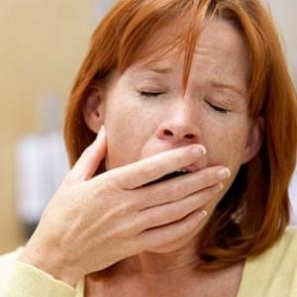
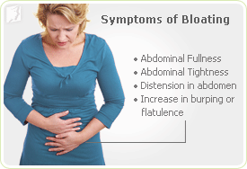
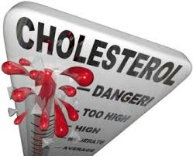
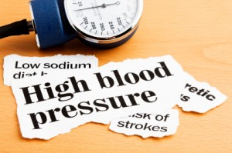
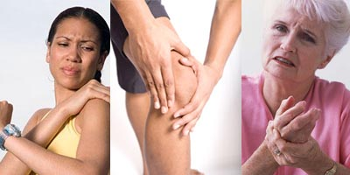
Is this you?
Low Energy & Fatigue |  | Abdominal Bloating
Mood Swings |  | Excess Weight
Anxiety |  | Joint Pain
Poor Sleep |  | Skin Problems
Brain Fog |  | High Cholesterol
Lack of Focus |  | High Blood Pressure
Depressed

Slide 4
It’s Simple - It’s a Lifestyle
It’s a Plan, not a DIET
It’s not a rapid weight loss program
It’s not a once a year detox program
It’s a lifestyle that is easy to follow,
It’s easy to learn and easy to sustain
It’s family friendly
It’s designed for everyone

Slide 5
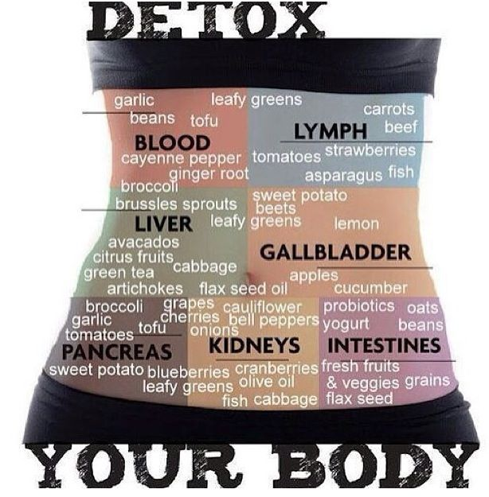
What WILL our Plan do?
Remove toxins from your body
Reset your metabolic thermostat
Reduce food cravings
Renew unhealthy skin
Reveal foods that harm your
health
Rediscover YOUR health,
vitality, energy, sex drive,
excitement & beauty

Slide 6
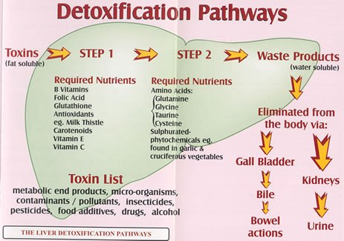
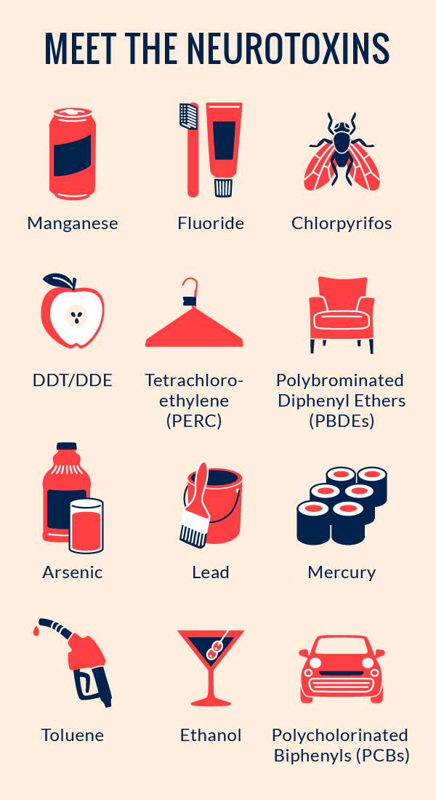
Your Body can Heal Itself
We Ingest Toxins in three ways
Our Lungs: the air we breath
Our Mouth: the food we eat
Our Skin: the products we use
Fact: Some are avoidable!
Most are by choice!
Arbonne Essentials unlock your body’s natural ability to
Heal Itself from The Inside Out

Slide 7
The 5 Keys to Health
Eat Clean
Eliminate Acidic, Allergenic & Addictive Foods
Increase Nutrient Absorption
Balance Blood Sugar
Support Elimination Organs
Fit Fact: We Don’t Lost Weight To Get Healthy
We Get Healthy And Lose Weight

Slide 8
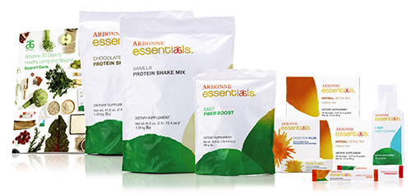
EAT CLEAN
Arbonne Essentials are:
Pesticide, Hormone & Antibiotic FREE
Saturated & Trans Fat FREE
Dairy, Gluten, Soy & GMO FREE
Refined Sugar FREE
Artificial Flavour & Sweetener FREE
Fit Fact: Eating a CLEAN, anti-inflammatory diet helps the body release toxins

Slide 9
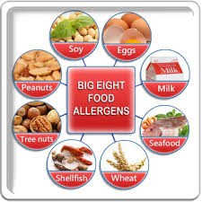
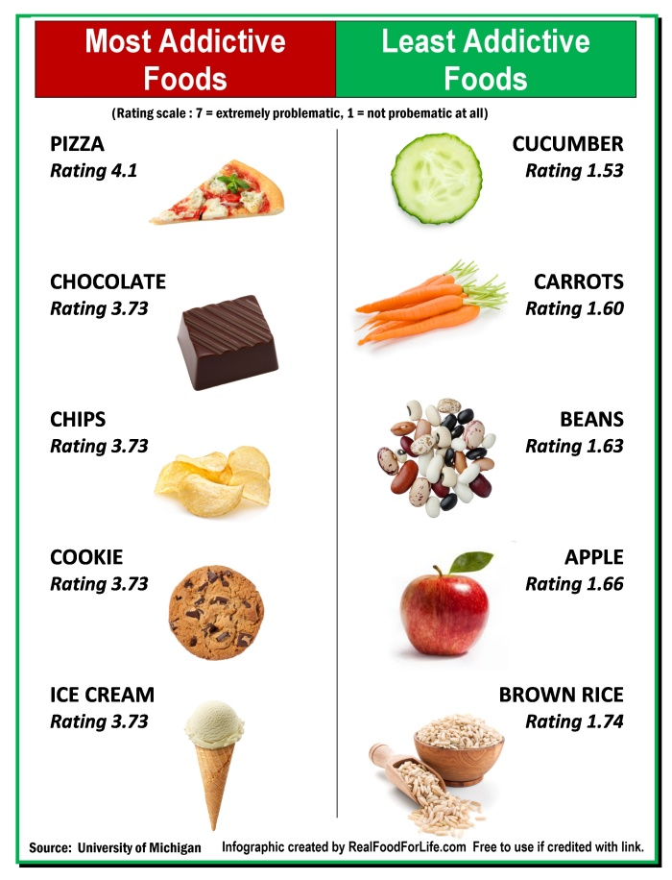
Eliminate the 3 A’s Acidic, Allergenic & Addictive foods
Refined Sugar . . Acidic & Addictive
Dairy . . . . . . . . . Acidic & Allergenic
Gluten . . . . . . . Acidic & Allergenic
Soy . . . . . . . . . . Acidic & Allergenic
Coffee . . . . . . . Acidic & Addictive
Alcohol . . . . . . Acidic & Addictive
Corn . . . . . . . . Acidic
The Food you Crave is the Food that is Killing You!

Slide 10
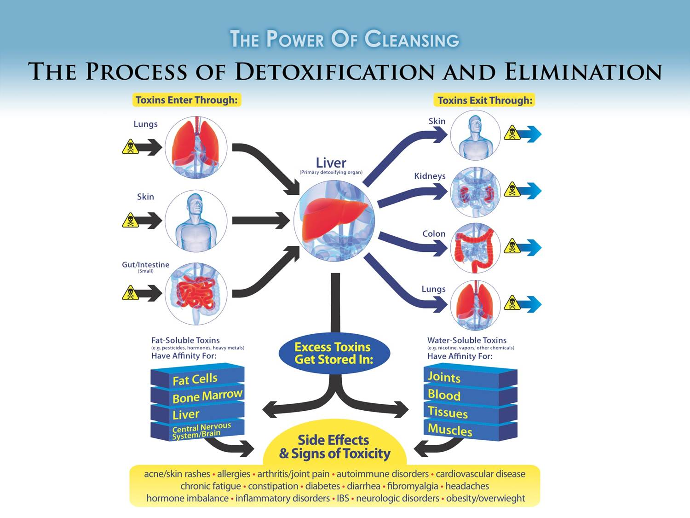
Increase Nutrient Uptake
Detoxification is essential
to begin increasing our
Nutrient Uptake
(Absorption Of Nutrients)
It’s Not What we Eat, its What we Absorb
When we are Toxic our Bodies Cannot Absorb the Good Nutrients we are eating
We need Essential Supplements & Anti-oxidants to Process and Digest our Foods
Digestion Enzymes, Probiotics & Vitamins are Key!

Slide 11
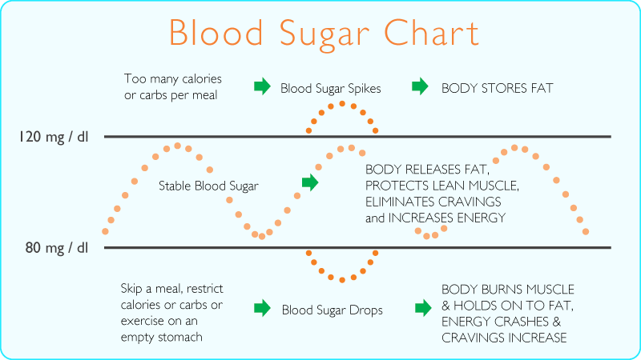
Balance Blood Sugar
Insulin is secreted in response to eating Acidic Carbohydrates
(bread, crackers, biscuitss, white potatoes, fruit, sugar, etc.)
Insulin Signals the body to bring the Blood Sugar Down &
to HOLD ON to FAT!
Scientists have established that anything that causes a rise in our Blood Sugar results in Inflammation
Fit Fact: Inflammation is at the basis of virtually every disease process such as Cancer, Aging, Alzheimer’s, Heart Disease and Wrinkled Skin Dr. Nicholas Perricone

Slide 12
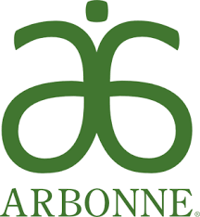
Support Elimination Organs Liver, Kidneys, Blood & Skin
Strive to continually support these crucial organs
Safely support and cleanse through a clean diet and clean supplements
Use clean and safe personal care products
Make the right choices everyday

Slide 13
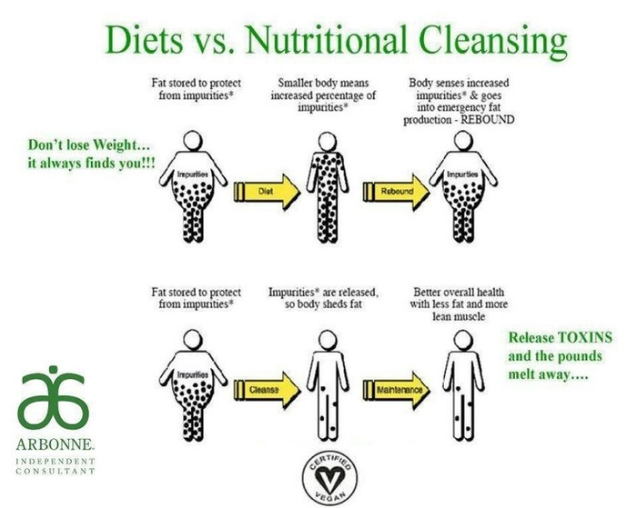
Remove Toxins = Lose Fat
The body forms fat cells
around toxins to protect
vital organs
The more toxins in your
diet, the more difficulty
losing weight – this is
why many plateau or get
stuck
Remove Toxins and Lose
Weight
What is a toxin?
Anything your body cannot use as energy (what your body can absorb & use as fuel)

Slide 14
Inflammation = Disease
Acidic/Low pH = Inflammation = DISEASE
Food is either Acidic / Alkaline (pH balanced)
Mildly Acidic Bodies eventually lead to
Cancer * Heart Disease * Type2 Diabetes * Insulin Resistance
Stroke * Hypertension * Osteoporosis * Acne * Fatigue * Cravings
Bladder Infections * Kidney Stones * Suppressed Immune System Autoimmune Diseases * Weight Gain * Low Energy * Chronic Fatigue Accelerated Aging * Alzheimer’s Disease * Dementia
Aching Muscles * Joint Pain * Rheumatoid Arthritis * Slow Digestion
IBS * Crohn’s Disease * Fungal Overgrowth
Fit Fact : Mildly Acidic Bodies get STRESSED & INFLAMED, which is a breeding ground for inflammatory based diseases

Slide 15
The answer? Eat More Alkaline Forming Foods
The 7 most alkaline foods (foods that absorb acids are:
Spinach
Kale
Cucumber
Broccoli
Avocado
Celery
Peppers

Slide 16
What’s the Deal with Dairy?
Dairy is Acidic & Allergenic
Dairy is full of Hormones and Antibiotics
Dairy contributes to Acne & is Mucus Forming
The Countries with the highest Consumption of Dairy have the Highest Rates of Breast Cancer and Osteoporosis
The EPA States 100% of Beef and 93% of Cheese and Ice Cream is Contaminated with DDT (a harmful chemical insecticide)
Fit Fact:
Whey is a major contributor to intestinal toxemia which leads to
the overgrowth of bacteria . Toxemia can lead to IBS or Crohn’s
Disease

Slide 17
Why No Gluten & Soy
Gluten is found in Wheat, Rye & Barley (Beer).
Gluten & Soy are Acidic Proteins (*Not Alkaline).
Difficult to digest & Allergenic.
The Immune System often attacks these proteins,
causing Inflammation, bloating and potbelly.
Gluten inflames the Intestines, makes it leak into the
Blood stream/Body, which causes the bloating.
Soy Contains Phytoestrogens, which can mimic the effects of the female hormone estrogen.
Oestrogen can lead to cancers in women & feminization of
men & damages of whey can eventually lead to kidney failure

Slide 18
Arbonne Scientific Advisory Board
Arbonne is partnered with 7 Medical Doctors that make up our Arbonne Scientific Medical Advisory Board.
The medical community recognizes what ARBONNE is doing as TRUE HEALTH & WELLNESS and they are eager to provide their insight, information and innovation! Partnering with us to help
EDUCATE everyone with this information.
Fit Fact: ARBONNE is backed By THE MAYO CLINIC

Slide 19
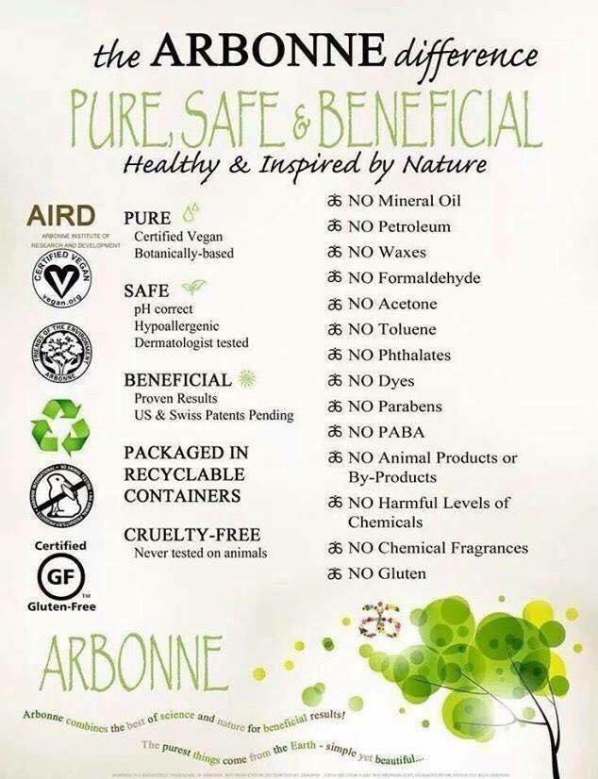
Why Arbonne & How Can We Help?
Arbonne Fit & Daily Essentials are
FREE of:
Dairy
Gluten & Soy
GMO
Refined sugar
Artificial Colours
Artificial Flavours
Animal by-products
Artificial sweeteners
Saturated Fat
Trans Fat
Lactose
Cholesterol
Fit Fact: Arbonne is Certified Vegan

Slide 20
Arbonne makes it easy to keep on track
Arbonne Essentials can enhance Nutrient Uptake &
decrease Toxic Load simultaneously
Fit Facts:
Nothing tastes as good as
Healthy Feels
YOU cannot Exercise Out
a BAD diet!
Ageing is 10% genetics,
10% exercise and 80% of
what we eat & put on our skin
We need to Nutritionally Rebalance our bodies
for true Health and Wellness

Slide 21
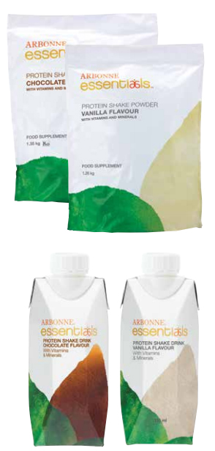
Replace Dairy, Gluten & Soy
Arbonne Vegan Protein Shake Mix
20 g Vegan Protein – Highly absorbable
20 Essentials Vitamins and Minerals (feel full longer)
Complete Amino Acid Profile
Pea, Cranberry & Brown Rice combination
rivals animal protein
Cholesterol, Lactose & Trans Fats FREE
Artificial Sweetener, Flavour & Colour FREE
Helps Build & Maintain Lean Muscle
Inner Gplex To Promote Energy & Detoxification
– ginseng, alfalfa, kelp, CoQ10, Flaxseed

Slide 22
Replace Coffee, Tea and fizzy drinks
Arbonne Energy Fizz Sticks
Alkaline Forming & All Natural
Green Tea, Ginseng, B Vitamins
Refined Sugar And Artificial Sweetener FREE
High Fructose Corn Syrup FREE
Just 10 Calories & Carb FREE
Provides CALM Energy
Helps reduce sugar & carb cravings
Balances Blood Sugar, Boosts Energy, Improves Mood,
Enhances Endurance and Improves Alertness
Simply add to 16-24 oz of water

Slide 23
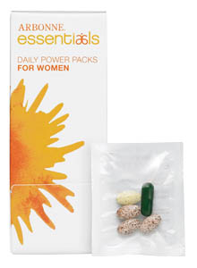
Supplement & Absorption Daily Power Packs for Women
Fight Oxidative Stress (number 1 Cause Of Ageing)
Whole Super Food Antioxidants: Green Tea, Grape Seed
Extract, Cranberry, Black Currant, Reservatrol, Pomegranate
to Accelerate Detoxification
Chelated Minerals for High Absorbability
Digestive Enzymes that Support GI Health
Prebiotics Prepare the Gut for Probiotics
Probiotics - Friendly Bacteria
HIGHLY ABSORBABLE – Studies show patented BioPerine
give increased absorption levels of 60%
Nutritional packs including 20 essential vitamins, minerals,
botanicals, probiotics, and enzymes plus bone health and antioxidant formulas.
Cold pressed rather than heat pressed, which allows for maximum absorption quality
Supports:
Digestive health, bone health, joint health, cardiovascular health and cognitive health
Convenient daily packs ensure proper dosing, 30 for one a day.

Slide 24
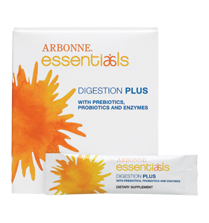
Nutrient Absorption Help
Arbonne Digestion Plus
• Supports digestion of carbohydrates, fats, protein, fibre and lactose
• Supports healthy digestion to help
minimize gas and bloating
• Promotes balance in the intestinal tract
• Supports nutrient uptake from the
foods we eat
Every day add a single serving stick pack of mild powder
to any cold or room-temperature liquid.

Slide 25
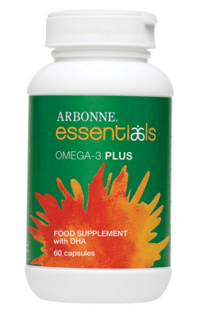
Omega 3 Plus
Vegan capsules filled with flaxseed oil and vegetarian DHA derived from algae
Provide daily omega-3 fatty acids
Help support cognitive health
and/or brain function
No fishy taste!
60 capsules/30 day supply

Slide 26
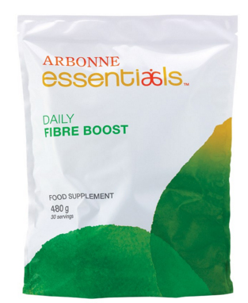
Support Elimination Organs ARBONNE DAILY FIBRE BOOST
Helps lower bad & raise good Cholesterol
Helps Balance Blood Sugar
Fibre is a sponge for Toxins & Protects the Colon lining
Helps you feel fuller longer
Made from Fruits and Vegetables
One serving = nearly ½ the recommended
daily amount
Odourless, Colourless & Tasteless
Convenient way to get 12 grams of fibre.
This heat resistant blend of gluten free grain and
fruit fibres can be added to hot or cold foods, drinks
and even baked goods.

Slide 27
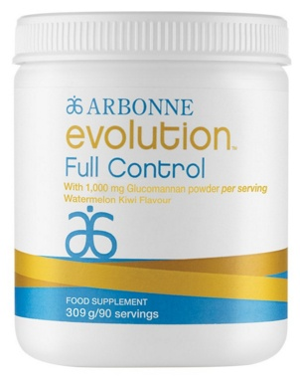
Arbonne Evolution – Full Control
Full Control - Helps support blood sugar and cholesterol levels already within normal range.
Contains Glucomannan, a fibre derived from the konjac root, which is capable of absorbing 100 times its weight in water
Fibre expands in the stomach and small intestines to help support weight management
Magnesium contributes to normal energy yielding metabolism and maintenance of normal bones and teeth
The key ingredient glucomannan contributes to weight
loss, in the context of an energy restricted diet,*
and supports GI health.
Helps support the Gastrointestinal System
Helps support blood sugar and cholesterol levels already
within the normal range.
Take 30 mins. before meals to restrict appetite & help control
over-eating.
Watermelon kiwi flavoured powder can be added to water, at only
5 calories per serving.
Gluten free and vegan certified.

Slide 28
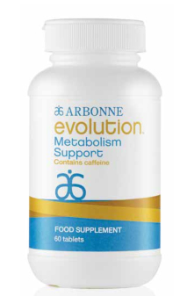
Arbonne Evolution – Metabolism Support
Helps support metabolism
Contains a natural blend of botanicals
Easy to use supplement fits effortlessly into any busy lifestyle
Formulated without harmful ingredients found in many over the counter supplements
Gluten free and vegan certified
Utilise both Arbonne Evolution products.
Chromium in Metabolism Support contributes to normal macronutrient metabolism.
Glucomannan in Full Control contributes to weight loss, in the context of an energy restricted diet.
These products work best when used together, and can be used in conjunction with the 30 Days
to Healthy Living and Beyond product collection. The combination allows you to achieve a
healthy lifestyle with a focus on weight management.
BENEFITS
Chromium contributes to normal macronutrient metabolism
How to use: Take one Metabolism Support tablet immediately before or with meals, twice daily.
Recommended with breakfast and lunch.

Slide 29
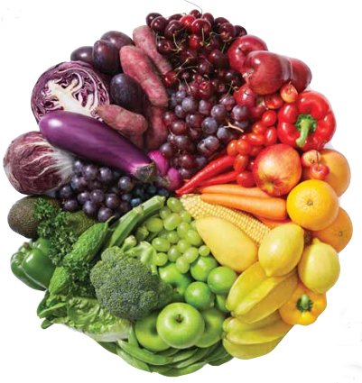
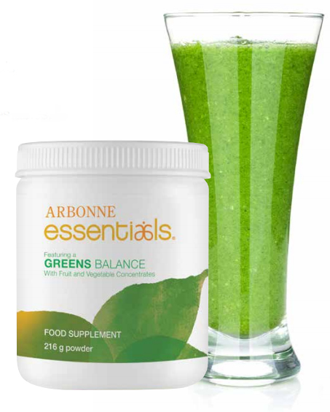
Arbonne Essentials – Greens Balance
One serving provides the nutritional benefit from 37 fruits and vegetables.
Contains 100% natural whole food.
Great tasting, convenient powder supplement to add to an Arbonne Essentials Protein Shake, Meal Replacement Shake, juice or water.
Contains prebiotic fibre, powerful phytonutrients and
antioxidants along with essential vitamins and minerals
Travel friendly vegetable/fruit serving.
Prebiotic fibre can help support a healthy digestive
system.
Helps make “smart” nutrition a convenient part of
a busy lifestyle.
One container has 30 servings to easily increase your daily intake
of fruits and vegetables.

Slide 30
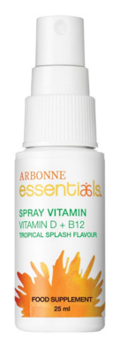
Arbonne Vitamin D & B12 Spray
Just a spray of sunshine!
If you are indoors a lot or are vegetarian, you might need a
boost of essential D + B12 vitamins daily to support
energy, immunity and calcium absorption.
Tasty Tropical Splash flavour.
Convenient and easy to use.
Fit Fact:
According to the Mayo Clinic, Vitamin D deficiency is associated with
Bone Loss, Osteoarthritis, Cognitive Issues, Kidney Disease,
Gastrointestinal Issues & Cardiovascular Disease.

Slide 31
Benefits of the Arbonne Essentials SimplyFit Nutritional Lifestyle Plan
Noticeable Loss of Body Fat/Increase in Lean Muscle Mass
Enhanced Athletic Results, Stamina & Performance
Improved & Balanced Blood Sugar Levels
Decreased Cholesterol & Blood Pressure Levels
Increased Energy and Quality of Sleep
Alleviation of symptoms of Arthritis and Muscle Soreness
Relief of Allergies and
Adverse Skin Conditions

Slide 32
Example of a daily plan

Slide 33
Sports Nutrition
If you exercise regularly you might be interested in Arbonne’s specially targeted Phytosport range

Slide 34
Did You Know?
All of the energy we need for life, as well as for exercise, comes from the Foods we Eat and the Fluids we Drink.
To perform at your body’s peak level, sports nutrition experts recommend a Balanced Diet and Active Lifestyle, as well as Specific Nutrients before and after a workout, along with plenty of fluids.
Every category of nutrition is important for overall health, but according to the British Dietetic Association, carbohydrates, proteins, fluids, and a varied, well balanced diet that supplies the right amount of energy and essential nutrients, play important roles before, during and after strenuous activity.

Slide 35
Carbohydrates
Carbohydrates are the most important source of energy for athletes, providing the energy that fuels muscle contractions. Once they are consumed, carbohydrates break down into smaller sugars absorbed by the body and used as energy. Any glucose not needed right away gets stored in the muscles and liver in the form of glycogen.
Glycogen is the source of energy most often used by the body during exercise. During longer periods of activity, fat can help fuel the body, but the process is slower and not ideal for efficient energy production.
According to the Food Standards Agency, 1 gram of carbohydrate provides 4 calories per gram of energy for the body. During exercise or activity, we use up stored carbohydrates in our muscles as fuel.
If we don’t replenish these stores, we can run out of fuel. To avoid running out of energy, start with full glycogen stores, replenish during exercise and refill after exercise.
Simple carbs, or sugars, are absorbed by the body and converted to energy very quickly and provide a rapid source of energy.
Complex carbohydrates take longer to digest and absorb into the body. This breakdown also requires more effort, so complex carbohydrates are converted to energy at a slower rate than simple sugars.

Slide 36
Proteins
Protein consists of amino acids that combine to make muscles, bone, tendons, skin, hair, and other body tissues.
Proteins also help our body transport nutrients and create enzymes, which trigger the multitude of biochemical reactions that occur daily in our bodies.
More than 10,000 types of proteins in the body complete all of these critical functions.
Essential amino acids must be obtained from the diet; therefore, it’s important to consume adequate amounts of high quality protein.
Athletes need protein to repair and rebuild muscle that gets broken down during exercise and to help with carbohydrate metabolism. Branched chain amino acids — like leucine, isoleucine and valine — help support muscle repair.

Slide 37
Fluids
Keeping your body hydrated is essential for everyone. Water is the most important nutrient and has many critical functions, including regulating temperature, lubricating joints and transporting nutrients as well as waste throughout the body.
Staying hydrated is especially important during exercise to ensure comfort, performance and good health. The longer and more intense the exercise, the more important it is to drink the right kind of fluids. Studies have found that athletes who lose as little as 2% of their body weight while sweating can experience a drop in blood volume, causing the heart to work harder to circulate blood. This can lead to muscle cramps, dizziness, fatigue and heat related illness.
Electrolytes regulate muscle function and nerve function, hydration, blood pressure, and the rebuilding of body tissue. Our electrolyte levels can fluctuate when the water levels in the body change which occurs when our level of hydration goes up or down. Imbalanced electrolyte levels can lead to either weak muscles, or muscles that contract too severely and cramp during periods of exercise.
According to the British Journal of Sports Medicine, an athlete’s need for electrolytes increases with exercise and heat stress from extensive sweating, which causes water and electrolyte losses, as well as extracellular and intracellular water distribution. Sodium and potassium are needed to help replace sweat related electrolyte losses, and sodium also helps stimulate thirst. Other electrolytes, such as calcium, magnesium, chloride, and phosphorus help maintain the acid base balance in the body and support muscle, nerve and cardiac function.

Slide 38
The Arbonne PhytoSport collection
Designed to deliver support to athletes and amateur activity enthusiasts.
The 3 step PhytoSport system has been created with scientific and natural botanical ingredients to deliver results that are fuelled by nature. The products do not contain ingredients typically found in competitive lines, such as whey, caffeine and soy, that some have sensitivity to, yet they help support physical exercise.

Slide 39
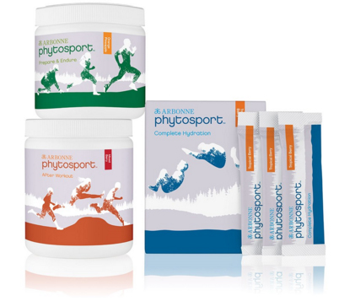
Phytosport Product Collection
Prepare & Endure
Complete Hydration
After Workout
All three PhytoSport products contain
our proprietary Arbonne PhytoSport
Blend of botanicals:
Ginseng (Panax ginseng) root extract: Supports energy, physical capacity and performance
Turmeric (Curcuma longa) root extract: Antioxidant; helps support joints
Cayenne (Capsicum annuum L.) fruit extract: Contains capsaicin

Slide 40
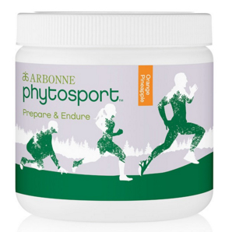
PREPARE AND ENDURE
Orange-pineapple flavoured food supplement provides simple carbohydrates that can be readily converted into functional energy to help support your physical exercise
Features B vitamins and vitamin E, which contribute to the protection of
cells from oxidative stress and help reduce tiredness and fatigue
Formulated for men & women aged 18 and older to support all levels
of activity
Vegan certified; gluten free; and formulated without artificial flavours,
colours or sweeteners
Benefits
Contains an exclusive blend of botanicals featuring ginseng and
turmeric to support energy, physical capacity, performance and joints
Thiamine contributes to normal functioning of the heart
Riboflavin and vitamin E contribute to normal functioning of the heart
Riboflavin, folate, and vitamins B6 and B12 help reduce tiredness and fatigue
Folate, plus vitamins B6, B12, and C, contributes to the normal function of the immune system
Vitamin C and riboflavin contribute to the protection of cells from oxidative stress
Vitamin C and thiamine contribute to normal energy yielding metabolism
Mix 1 scoop (16.4 g) with 250–500 ml of water prior to or during exercise

Slide 41
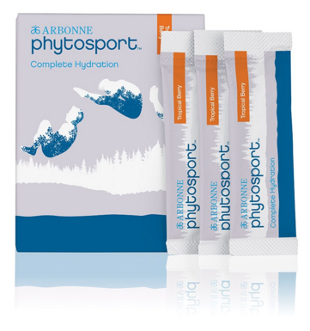
COMPLETE HYDRATION
Delivers electrolytes to support hydration
Formulated for men and women aged 18 and older to support all
levels of competitive activity
Tropical berry flavour
No artificial flavours, colours or sweeteners
Vegan certified, gluten free
Benefits
Contains an exclusive blend of botanicals featuring ginseng and
turmeric to support energy, physical capacity, performance and joints
Vitamin C contributes to maintaining the normal function of the immune
system during and after intense physical exercise (when consuming 200 mg
in addition to the recommended daily intake of 80 mg of Vitamin C)
Vitamin E contributes to the protection of cells from oxidative stress
How to Use
Mix contents of one stick pack with 500 ml of water. Hydrate before, during and after exercise.

Slide 42
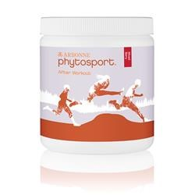
AFTER WORKOUT
Delivers the ingredients you need to enhance recovery so you can keep going
Add to the Arbonne Essentials Protein Shake or mix with water for a post workout protein and nutrient boost.
Formulated for men and women aged 18 and older to support all levels
of competitive activity
Vegan certified; gluten free; formulated without artificial flavours,
colours or sweeteners
Benefits
Contains an exclusive blend of botanicals featuring ginseng and
turmeric to support energy, physical capacity, performance and joints
Pomegranate contains specific compounds called punicalagins that act
as antioxidants
Turmeric is an antioxidant that also supports joints
Branched chain amino acids leucine, isoleucine and valine help support muscle
Vitamin B12 and magnesium contribute to normal energy yielding metabolism, reduction of tiredness and fatigue, and normal functioning of the nervous system
Vitamin B12 contributes to normal red blood cell formulation and function of the immune system
How to Use
Mix 2 scoops (12.4 g) with 500 ml of water or add to an Arbonne Essentials® Protein Shake. Ideally consume within 30 minutes of physical activity.

Slide 43
Some BEFORE and AFTER pics

Slide 44
THANK YOU!

